Slide 1

TEAM 07 MEMBERS :
VISWANATHAN.S PRASANTH.T ANBUMANI.C RISHAB KUMAR.V
GUIDE :
Dr. N. JAISANKAR - HOD/IT
D
DEEP LEARNING TECHNIQUES BASED ACCESS CONTROL SYSTEM (DLTBACS)

Slide 2
ABSTRACT:
In today’s highly dynamic and scalable IT environments, traditional access control systems like Role-Based Access Control (RBAC) and Attribute-Based Access Control (ABAC) struggle to meet growing demands.
They require manual policy engineering, which is time-consuming, error-prone, and difficult to scale.
This project proposes a Deep Learning Based Access Control System (DLBAC), where a neural network is trained on user and resource metadata to automate access control decisions.
Our approach focuses not only on automating decisions but also on enhancing explainability, robustness, and security. We aim to incorporate Explainable AI (XAI) methods, design lightweight neural networks, introduce context-awareness in access decisions, perform adversarial training for security, and apply robust AI techniques to handle noisy or incomplete data.
This system can significantly improve the scalability, adaptability, and reliability of access control mechanisms in complex environments like cloud computing, IoT, and large enterprises.

Slide 3
PROJECT OVERVIEW: OBJECTIVE:
Develop an intelligent and secure access control system using deep learning.
Working Principle:
Collect user and resource metadata.
Preprocess and encode features for model training.
Train a neural network to predict access decisions (Grant / Deny).
Integrate Explainable AI techniques to interpret model decisions.
Implement adversarial training to defend against manipulation attacks.
Design lightweight and context-aware systems to ensure real-time decision-making.
Expected Outcome:
A scalable, automated, explainable, and secure access control system that reduces manual intervention and enhances organizational security.

Slide 4
PROBLEM STATEMENT:
Traditional access control systems like RBAC and ABAC require manual creation and maintenance of access policies.
This process is tedious, prone to human error, and not scalable for dynamic environments such as cloud platforms, IoT networks, and large enterprise systems.
Moreover, these systems often lack the flexibility to adapt to changing user behavior and emerging threats.

Slide 5
PROPOSED SOLUTION:
We propose DLBAC — a deep learning-based solution to automate access control decisions.
MAIN GOALS:
Automate access decisions without manual rule creation.
Enhance accuracy and scalability across dynamic environments.
Develop Explainable AI (XAI) to make decisions transparent.
Design Lightweight Neural Networks for faster, resource-efficient deployment.
Enable Context-Aware Learning considering time, location, and device context.
Integrate Adversarial Training to improve defense against attack manipulation.
Apply Robust AI Techniques to handle incomplete, noisy, or biased data inputs.

Slide 6
METHODOLOGY:
Data Preparation
Collect metadata (user details, resource details)
Preprocess data for training (encoding, cleaning)
2. Model Training
Train DLBAC neural network with metadata and access tuples
3. Access Decision Engine
Use trained model to predict grant/deny decision
4. Explainability Layer
Apply XAI techniques to interpret decisions
5 Security Hardening
Implement adversarial training and robustness checks

Slide 7
MODULE BREAKDOWN & IMPLEMENTATION PLAN
Module | Description | Status
Data Collection & Preprocessing | Gather and encode user/resource metadata | Done
Model Training | Train neural network on metadata and access tuples | Basic model ready
Access Decision Engine | Take inputs and predict access decisions | Prototype ready
Explainability (XAI) | Apply Integrated Gradie or interpretation | Planned
Security Adversarial Training | Train model against adversarial attacks | Planned
Robustness Techniques | Handle incomplete, noisy, or biased data | Planned

Slide 8
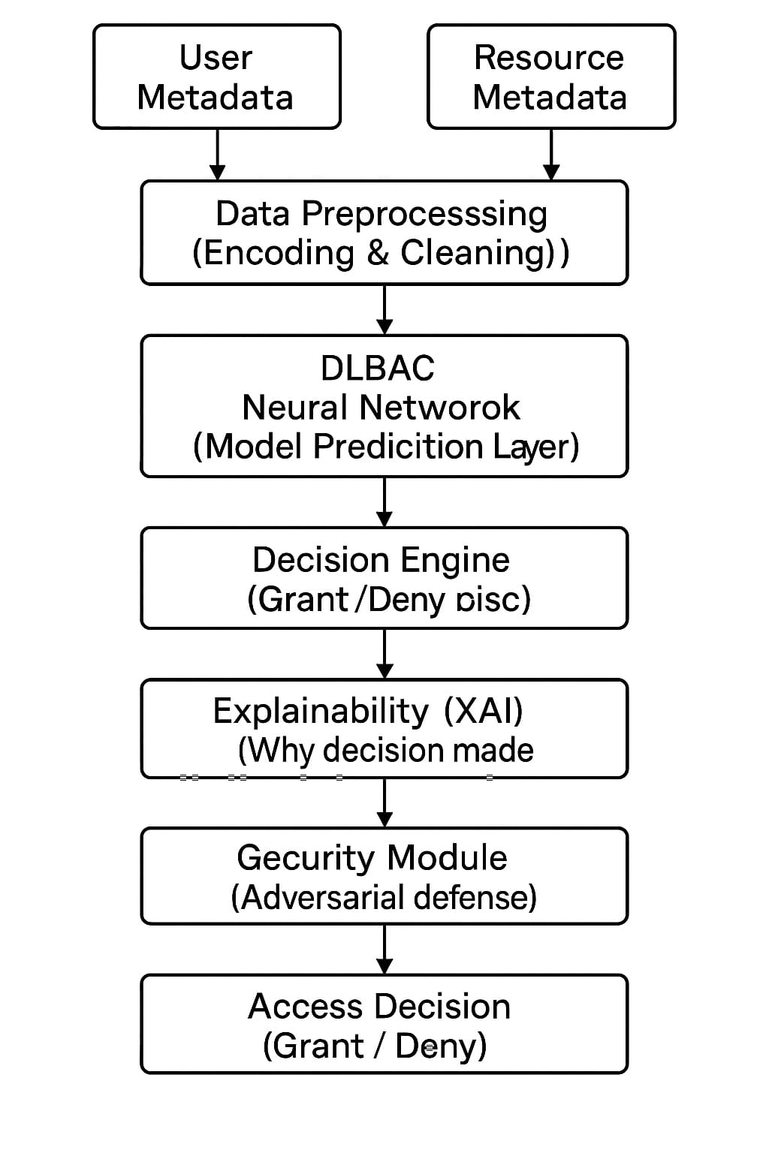
BLOCK DIAGRAM: PROCESS
SYSTEM OVERVIEW:

Slide 9
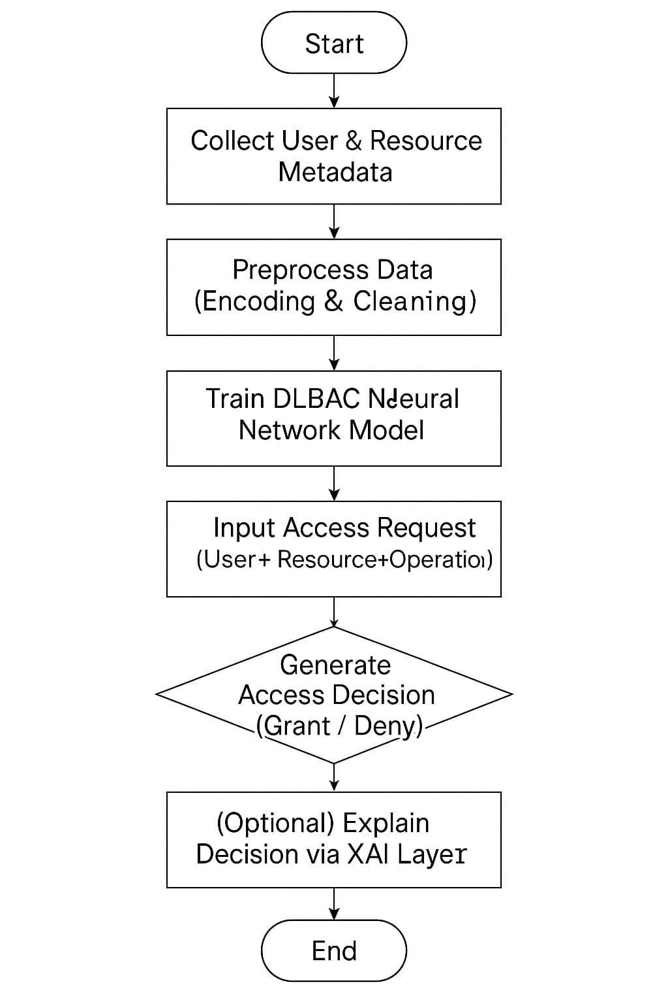
FLOW CHART : METHODOLOGY
STEP-BY-STEP PROCESS :

Slide 10
FUTURE IMPROVEMENTS:
Explainable AI (XAI):
Integrate techniques like Integrated Gradients to explain why a decision was made.
Improve transparency and trust.
Context-Aware Learning: Include real-time factors like device trust, location, and access time into decision-making.
Adversarial Training: Train models to detect and defend against maliciously manipulated access requests.
Lightweight Neural Networks: Optimize the model to reduce size and computation for faster, efficient access predictions.
Robust AI Techniques: Handle missing, noisy, or inconsistent metadata.
Ensure fairness and resilience in access control decisions.

Slide 11
Challenges and Solutions in DLBAC:
Problem: How can we explain why the model made a Grant or Deny decision?
Solution: Integrate Explainable AI (XAI) techniques like Integrated Gradients.These methods highlight which metadata (user/resource features) influenced the model's decision.
2. Problem: How can we defend the model from adversarial attacks that manipulate metadata?
Solution: Apply Adversarial Training by injecting intentionally manipulated examples during model training. This improves model robustness against attacks trying to bypass security.
3. Problem: How do we handle bias or missing data in the training dataset?
Solution: Perform Data Cleaning and Preprocessing to remove inconsistencies.Use Bias Detection Techniques and Data Augmentation to ensure fair and balanced training data.

Slide 12
Challenges and Solutions in DLBAC:
4. Problem: How can we make the model generalize well to new, unseen users and resources?
Solution: Use Robust Validation techniques with unseen testing data. Implement Lifelong Learning methods to allow the model to adapt over time.
5. Problem: How do we reduce the high computational cost of deep learning models?
Solution: Design Lightweight Neural Networks by pruning unnecessary neurons and optimizing the architecture. Use techniques like model compression to make deployment faster and cheaper.
6. Problem: How can the model consider real-world changing factors like time, location, and device type?
Solution: Add Context-Aware Metadata as part of the input features. Train the model to factor in environmental contexts (e.g., time of access, device security level, location).

Slide 13
CONCLUSION: SUMMARY OF THE PROJECT:
A deep learning-based access control system (DLBAC) was proposed and developed to automate access decisions.
The system reduces manual policy engineering, improves scalability, and adapts better to complex environments.
Challenges like explainability and security were identified and strategies for future improvements were outlined.
DLBAC has strong potential to modernize traditional access control systems, making them smarter, faster, and more secure.

Slide 14
Next Steps:
Integrate explainability modules.
Implement security hardening through adversarial training.
Test and validate on larger real-world datasets.

